Slide 1
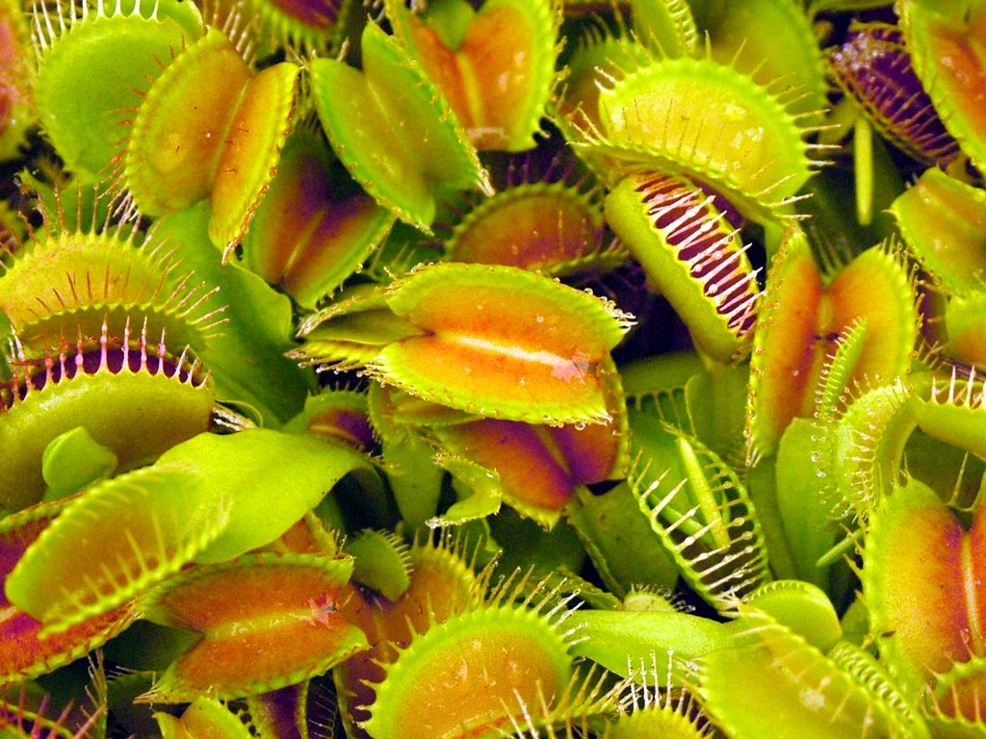
Biotic Relationships

Slide 2
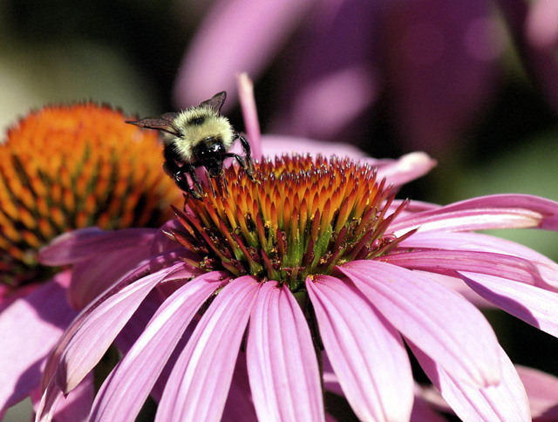
There are three types of relationships between living organisms: PREDATION, SYMBIOSIS, COMPETITION

Slide 3
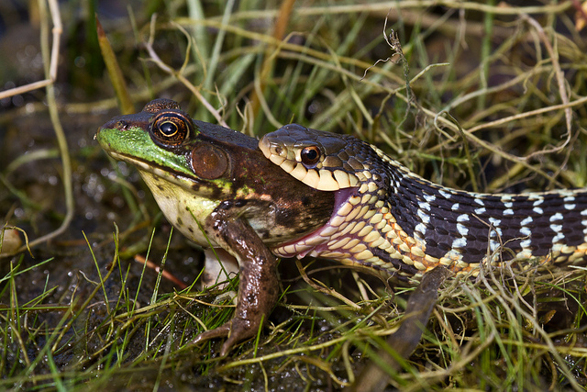
PREDATION Occurs when one organism eats another organism to obtain food
-Prey: the organism that is eaten
-Predator: the organism that eats
-Example: snake and frog, lion and deer, etc.

Slide 4
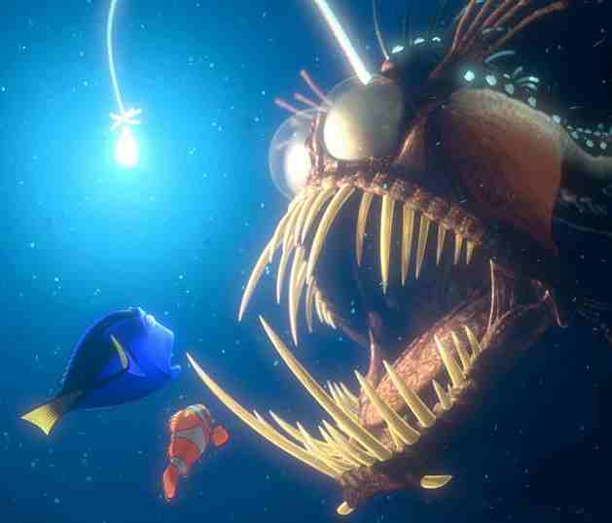
SYMBIOSIS Close interaction between two different species in which members of one species lives in, on, or near members of the other species
AHHH! These anglerfish can be over 1 meter in size!
Bioluminescent bacteria live in the spine extending from the female fish’s head.
-There are three types of symbiotic relationship:
mutualism, commensalism, parasitism

Slide 5
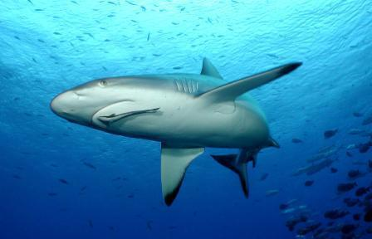
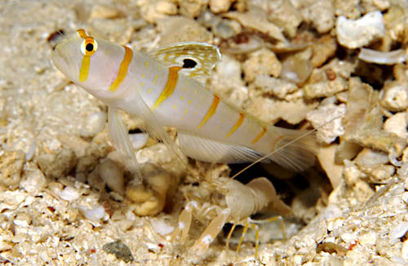
Symbiosis: Mutualism, Commensalism, Parasitism Mutualism Occurs when both species benefit from the relationship
The pistol shrimp builds a home for both the shrimp and the goby to live in. The goby fish has better eyesight than the shrimp and can watch for predators.
The shark provides the remoras with transportation, food, and protection. The remora maintains the shark’s health by eating parasites on the shark’s skin.
-Example: Goby fish and shrimp, shark and remoras

Slide 6
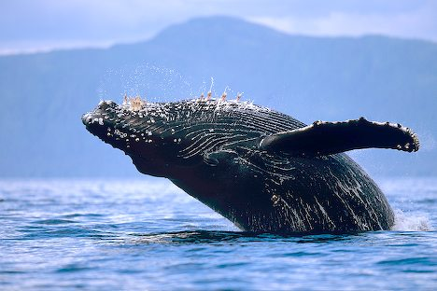
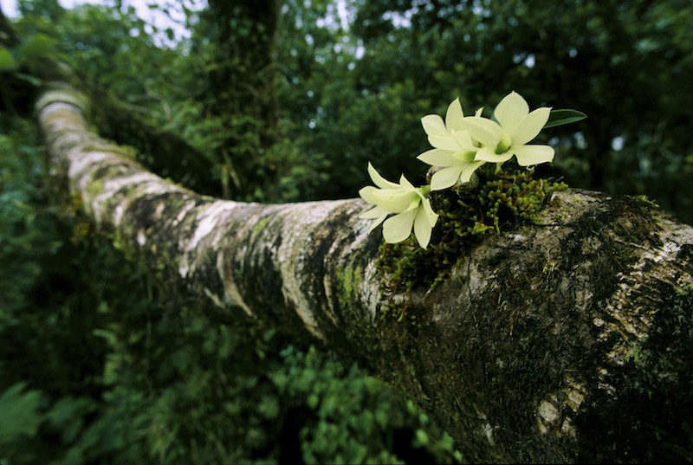
Symbiosis: Mutualism, Commensalism, Parasitism Commensalism Occurs when one species benefits from the relationship while the other species neither benefits nor is harmed
In order to better obtain sunlight, the orchid will grow on a tree trunk. The tree is unaffected by the orchid’s growth.
Adult barnacles are sedentary. By attaching themselves to a whale, they are provided with free transportation to food sources.
-Example: Orchids living on a tree, barnacles on whales

Slide 7
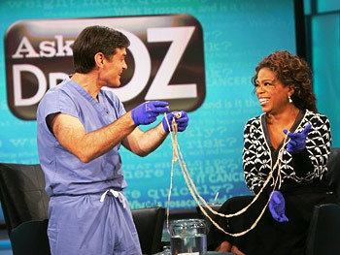
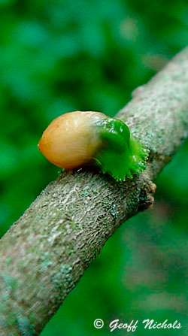
Symbiosis: Mutualism, Commensalism, Parasitism Parasitism One species lives on or in the other organism and feeds on it
When one of the mistletoe berries comes in contact with tree bark, it will send a thread like root into the bark. The mistletoe plant attaches itself to the tree. The mistletoe feeds off of the host plant’s food and water.
Tapeworms attach themselves to the insides of human, cow, and pig intestines. They eat the host’s partially digested food (depriving the host of nutrients).
-Example: Tapeworms in pigs, bacterial disease, insects sucking blood from other animals

Slide 8
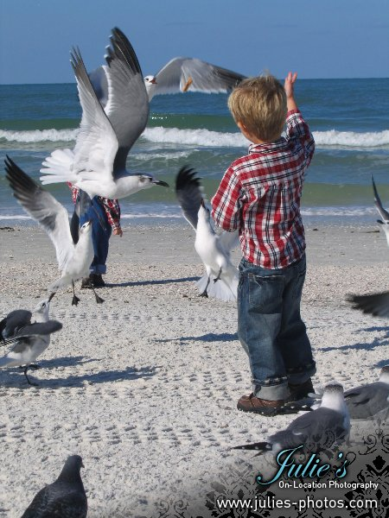
COMPETITION Interaction between two or more organisms competing for the same resource within a given habitat
-There are two types of competition:
-Competition WITHIN THE SAME species (intraspecific competition)
-Competition BETWEEN species (interspecific competition)

Slide 9
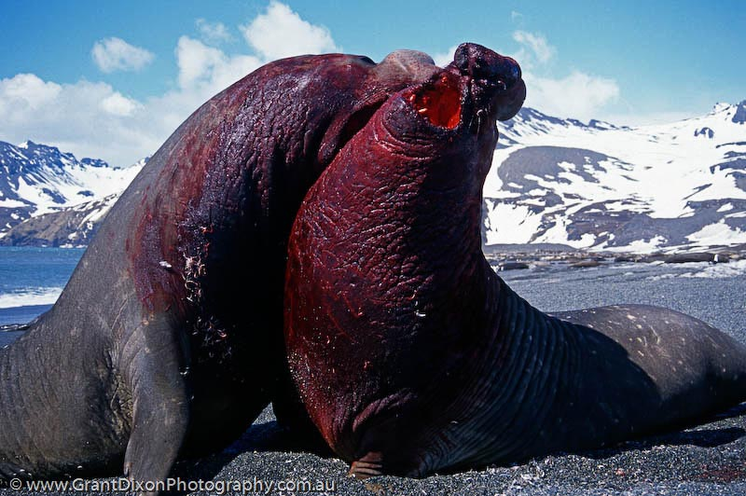
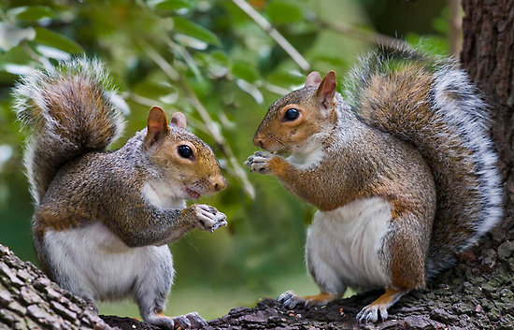
Competition: Intraspecific Competition, Interspecific Competition Intraspecific Competition Individuals compete with members of the same species for a resource (food, light, mate, etc.)
Squirrels compete with each other for food.
Elephant seals compete with each other for mating dominance. They can weigh up to 8,800 lbs!!
-Example: Squirrels for food, elephant seals for mates

Slide 10
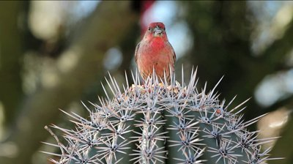
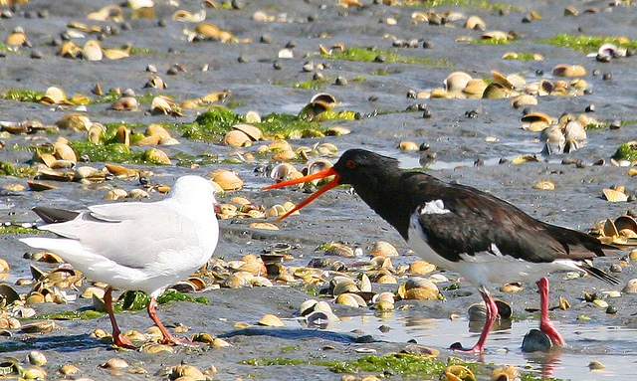
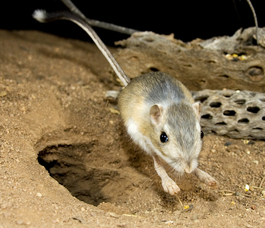
Competition: Intraspecific Competition, Interspecific Competition Interspecific Competition Individuals compete with members of other species for a resource (food, habitat etc.)
Oystercatchers will chase away gulls, crows, and ravens from their territory.
The kangaroo rat and various desert birds compete with each other for seeds.
-Example: Kangaroo rat and desert birds, oystercatchers and gulls

